Slide 1
State Machines

Slide 2
A state machine is an abstract concept, like a flowchart, that describes the action of a system through inputs, outputs and “states”.

Slide 3


Slide 4
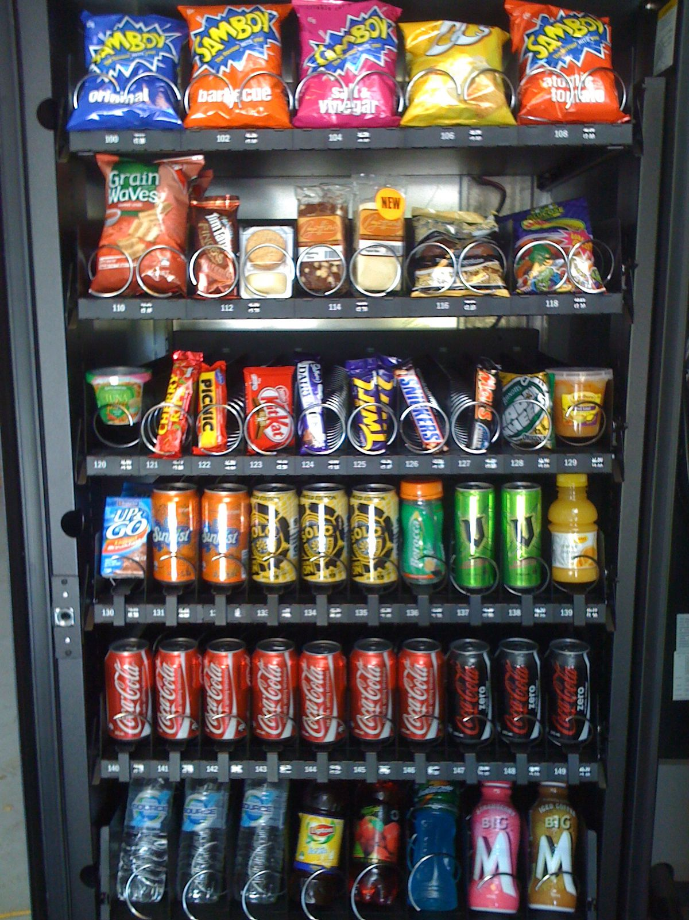
Example:
Insert Coin
Ready
Credits Available
Insert Coin
Bad selection or empty
Credits Enough?
Product
Selected
Product Dispensed

Slide 5
The circles are “states” – ways to describe how the system is at any given point. The arrows are “inputs” – events that change the state of (transition) the system.

Slide 6
Notice that the state machine describes a very simple “computer” with, essentially one memory item – the current state.

Slide 7
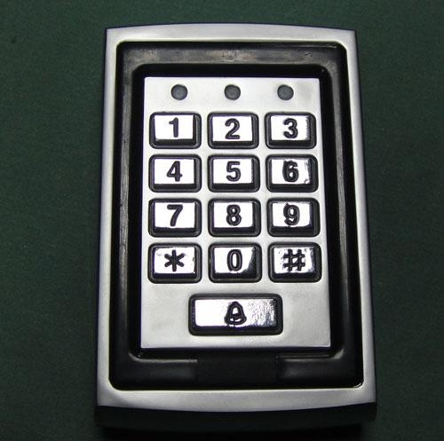
Another Example:
#2 correct
#3 correct
Enter
Third
Number
Second
Number
#1 correct
Enter
First
Number
Other Number
Enter
Ready
Other Number
Other Number
Other Number
Unlock
Enter
Wrong Number
Enter
Final State

Slide 8
λ
Lambda – what and why?
Theoretical Computer Scientists use the Greek letter lambda to indicate a state transition without input.
Why? Some state machines are easier to think about and draw with lambda transitions.

Slide 9
Think of lambda as the “when I can change state but I can’t ‘use up’ an input to get there’” operation. It works almost like a look ahead operator. It implements acceptance of an optional state.
For example – a class in Java can be static optionally
λ
public
Re class
static

Slide 10
This is the difference between two types of automata – DFA and NFA

Slide 11
NFA (nondeterministic finite automata)
Has lambda transitions
An input CAN go to any number of states

Slide 12
An input CAN go to any number of states?
C
S1
Final
C
λ

Slide 13
Computers “don’t deal well” with that sort of ambiguity. They “need” certainty and a clear algorithm.

Slide 14
DFA (deterministic finite automata)
Does not have lambda transitions
An input CAN go to one and only one state

Slide 15
DFAs are very simple to translate into code
and they are fast. One character yields one well defined state transition.

Slide 16
NFAs are more difficult to translate into code and they are slower. When determining the state transition to make, you have to look ahead to determine which state “path” will work OR you have to try one and then (potentially) backtrack.

Slide 17
A
A
A
S1
S1
S1
Final
A
A
A

Slide 18
One thing that you can use a state machine for is to determine if a sequence matches a “language” – a defined pattern.

Slide 19
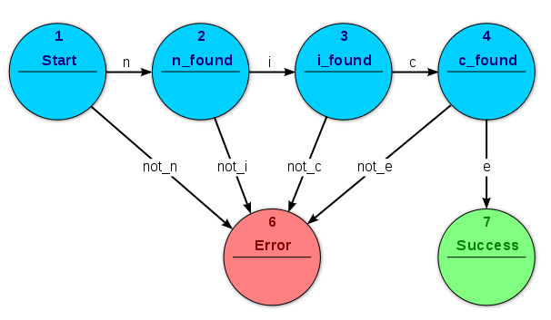
Determine if the input string matches “nice”

Slide 20
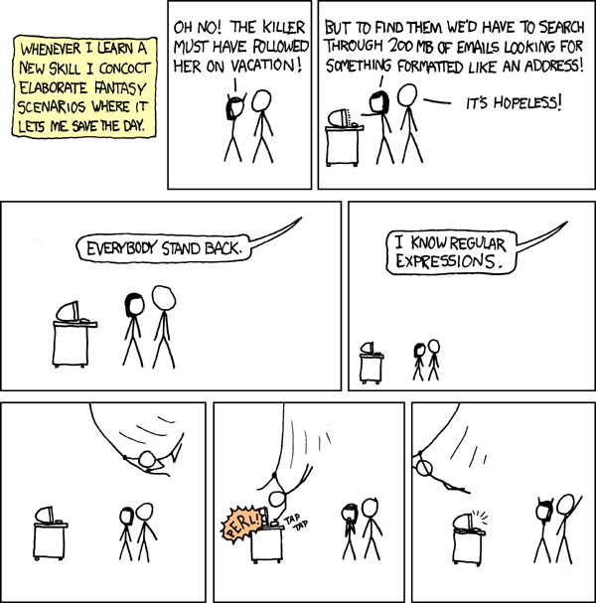
This concept is so powerful that it is the basis of a significant “concept” in Computer Science – regular expressions.
Nearly every programming language includes “regex” functions/methods/classes.
UNIX tools that use regex include Grep, Sed, Awk, Vi, Emacs, etc.
Learn and use regex’s, but understand that there are problems that they CAN NOT solve – XML & HTML parsing, for example.

Slide 21
A regular expression is simple language
that describes a search pattern for strings.

Slide 22
The Basics
Name | Definition | Example
Literal | Appears in the output | Nice
Bracket Expressions | Match any character in the brackets | [123] matches 1,2 or 3
Bracket Ranges | Match range of characters in brackets | [1-3] is the same as above
Negated Brackets | Match any character NOT in the bracket | [^0-9] matches non-numbers
Alternation | EITHER this or THAT | A|B matches A or B
Parenthesis | Groups characters together | (W|L)in matches Windows or Linux
Escape | Special characters appear in the output | \(\) matches () and doesn’t group

Slide 23
Some Examples:
I want to match | Regular Expression
Friend | Friend
Student0000 (where 0000 is any 4 digit number) | Student[0-9][0-9][0-9][0-9]
a vowel | [aeiou]
Happy or Sad | (Happy)|(Sad)
An area code | \([0-9][0-9][0-9]\)

Slide 24
Duplication, Repetition & Redundancy
Name | Definition | Example
Optional | Appears 0 or 1 time | AQ?B is matched by AB or AQB
Kleene Star | Appears 0 or more times | AQ*B is matched by AB, AQB or AQQQQQQQQQQQQQQB
Kleene Plus | Appears 1 or more times | AQ+B is matched by AQB, AQQQQB, but not by AB
Repeat Braces Exact | Appears N times | [0-9]{10} matches a 10 digit number
Repeat Braces Between | Appears between M and N times | [0-9]{2,4} matches 2,3 and 4 digit numbers
Repeat Braces At Least | Appears AT LEAST N times | [0-9]{7,} matches number with at least 7 digits
The count goes AFTER the character to match

Slide 25
Examples
I want to match | Regular Expression
The letter A followed (maybe) by a 7 | A7?
The letter A followed by at least one 7 | A7+
The letter A followed by 0 or more 7’s | A7*
The letter A followed by 3-6 7’s | A7{3,6}
The letter A followed by 9 7’s | A7{9}
The letter A followed by at least 4 7’s | A7{4,}
The letter A followed by at MOST 8 7’s | A7{,8}

Slide 26
If you are thinking about this carefully, you will notice that the repetition operators are pretty redundant – most can be expressed in terms of others.

Slide 27
For example –
{0,1} = ?
{0,} = *
{1,} = +
{N,N} = {N}

Slide 28
So what does any of this have to do with state machines?

Slide 29
Regular expressions are IMPLEMENTED with a state machine!

Slide 30
A regular expression is “compiled” – processed into a state machine data structure. Matching then runs a simple algorithm on the data using the generated structure.

Slide 31
Literal:A
A
Parenthesis Groups: (Mad)|(Sad)
Character Classes: [A-C] or [ABC]
M
a
d
A,B,C
Negation: [^ABC]
S
a
d
FAIL
A,B,C

Slide 32
Repetition
Any number (Kleene Star): A*B
At least 3: A{3,}B
A
A
A
B
A
A
B
A
B
Any time there is a count (at least N, at most N, etc.), you need to create at least that many states
At least 1 (Kleene Plus): A+B
A
At most 3: A{,3}B
A
A
A
B
B
B
A
B
B

Slide 33
Example
Regular expression: AB*C+(D|E)
B
C
S1
S2
C
S4
D,E
S6
S1
A
S2
S3
S4
Others
Others
Others
FAIL

Slide 34
Regular expression: AB*C+(D|E)
Input | S1 | S2 | S3 | S4
A | 2 | Fail | Fail | SUCCESS
B | Fail | 2 | Fail | SUCCESS
C | Fail | 3 | 3 | SUCCESS
D | Fail | Fail | 4 | SUCCESS
E | Fail | Fail | 4 | SUCCESS
F | Fail | Fail | Fail | SUCCESS
G | Fail | Fail | Fail | SUCCESS
H | Fail | Fail | Fail | SUCCESS

Slide 35
Simple Regex Algorithm
state = 1
while (state != ‘SUCCCESS’ and state != ‘Fail’)
c = getcharacter
if (c == endOfInput)
return ‘Fail’
state = stateTable[state][c]
return state

Slide 36
Regular expression: AB*C+(D|E)
Input | S1 | S2 | S3 | S4
A | 2 | Fail | Fail | SUCCESS
B | Fail | 2 | Fail | SUCCESS
C | Fail | 3 | 3 | SUCCESS
D | Fail | Fail | 4 | SUCCESS
E | Fail | Fail | 4 | SUCCESS
F | Fail | Fail | Fail | SUCCESS
G | Fail | Fail | Fail | SUCCESS
H | Fail | Fail | Fail | SUCCESS
Simple Regex Algorithm
State = 1
while (state != ‘SUCCCESS’ and state != ‘Fail’)
c = getcharacter
if (c == endOfInput)
return ‘Fail’
state = stateTable[state][c]
return state
Examples
ABBBBCCCE
S1, S2, S2, S2, S2,S2,S3,S3,S3,S3,S4,SUCCESS
AE
S1, S2, Fail
B
C
S1
S2
C
S4
D,E
S6
S1
A
S2
S3
S4

Slide 37
What were those “S1” and “S2” things in the examples?

Slide 38
Those are called “derivations”. They are a lot like showing your work in a math class – they show how the input (the string we are checking) can, by following the rules, match.

Slide 39
There are two reasons that derivations are of value.
In theoretical computer science, these are used in proving or disproving that a particular input matches.
If you are writing a state machine, this can be debugging output that lets you understand why your program is working (or not).

Slide 40
Some other state machine examples:
Parsing (almost anything) – ex: parsing integers from text, CSVs from text
Border Gateway Protocol (core routing of internet)
Simple AI (think Roomba)
Programmable component with plugins

